Slide 1
Presentation on
Investigation of Assassination of
Mohtarma Benazir Bhutto Shaheed
(Case FIR No. 471, dated: Dec 27, 2007,
U/S 302, 324, 435, 436 PPC, 4/5 ESA, 7 ATA,
P.S City, Rawalpindi)
Counter Terrorism Wing
Federal Investigation Agency
Dated: 17-12-2012

Slide 2
PART – 1
POLITICAL VICTIMISATION
AND FORCED EXILE

Slide 3
OVERVIEW
POLITICAL VICTIMISATION
Throughout her political career, Mohtrama Benazir Bhutto experienced all kind of adversities – detained in jail, house arrests, political victimization and persecution by the political rivals. However, it could not stop her to serve her nation and the people.
Her father and two brothers were killed by forces with a particular mind set and the same mind set continued to haunt Mohtrama Benazir Bhutto Shaheed.
Mohtrama Benazir Bhutto was implicated in number of false and fabricated criminal cases after dismissal of her democratically elected Government in November 1996 by Saif-ur-Rehman at the behest of his political masters.

Slide 4
Political Victimization
The cases were fixed in a such a way that she had to run from one court to another court and one city to another city to fight legal battle.
Her political rival through Saif-ur-Rehman pressurized and intimidated the judge to give her “full dose”.
When the taped conversation of these characters with a particular mind set surfaced, the unjust and unlawful ‘conviction’ was set aside and the two judges, since elevated to Supreme Court had to go home.
In 1990, she had to experience the same political victimisation after dismissal of her government.

Slide 5
Political Victimization
Mr. Asif Ali Zardari was equally victimised and was kept in the jail without trial of any case and she was left alone to fight the mindset of hostile forces.
When Mohtarma Benazir Bhutto Shaheed felt threat to her life and the lives of her children, she was obliged to go into exile.

Slide 6
PART – II
PROCESS OF RECONCILIATION

Slide 7
PROCESS OF RECONCILIATION
Pakistan was being ruled by a dictator and there was no likelihood that the country would return to democracy in the near future, therefore, Mohtrama Benazir Bhutto felt it her national duty to struggle for restoration of democracy in the country.
She opted, therefore, to enter into dialogue with the dictator to force him to dose off his uniform and hold free, fair and transparent election in the country by providing level playing field to all the politicians including Mian Nawaz Sharif.

Slide 8
PROCESS OF RECONCILIATION
Mohtrama Benazir Bhutto Shaheed appointed Mr. Rehman Malik to initiate talks with MQM and at the same time with Military leadership.
She also instructed Mr. Rehman Malik to establish contacts with Mr. Ishaq Dar and Mr. Ghaus Ali Shah and both the leaders agreed to fight against the dictatorship together.
The leadership of both PPP and PML/N, as per initiative of Mohtrama Benazir Bhutto Shaheed, signed Charter of Democracy, in London.

Slide 9
DIALOGUE WITH
MILITARY LEADERSHIP – RESTORATION OF DEMOCRACY
Mr. Rehman Malik initiated the dialogue through Mr. Tariq Aziz and under the instructions of Shaheed Mohtarma Benazir Bhutto consequent to which a number of meetings took place with Military leadership in London.
Two meetings took place with Mohtrama Benazir Bhutto with two Generals from Musharraf side and Mr. Rehman Malik assisted her in two meetings with Pervez Musharraf.
Mohtarma Benazir Bhutto Shaheed had two major demands from Pervez Musharraf – (i) to give up his uniform before elections and (ii) early, fair and free and transparent elections.

Slide 10
DIALOGUE WITH
MILITARY LEADERSHIP –RESTORATION OF DEMOCRACY
Pervez Musharraf was reluctant to accept these demands but Mohtrama Benazir Bhutto Shaheed was determined to get these two demands fulfilled although she was threatened with cases against her.
Gen. Pervez Musharraf tried to drag off his feet from his pledges to which Mohtrama Benazir Bhutto forcefully resisted and forced him to stick to his promises.
Mohtrama Benazir Bhutto mustered the support of international community with the help of friendly countries and forced Pervez Musharraf to come on the table of negotiations.

Slide 11
Why Was Mohtarma Benazir Bhutto Assassinated?
Political Struggle 2000-2007
Gen. Pervaiz Musharaf in power October 1999- August 2008.
Mohtarma Benazir Bhutto remained in exile.
Govt. announced general elections for the end of 2007 and all major parties decided to contest general election.
Mohtarma Benazir Bhutto was determined to return to Pakistan.
Her return to Pakistan was a threat to Gen. Pervaiz Musharraf’s Govt. who demanded & insisted that she should return after the elections.

Slide 12
… Why Was Mohtarma Benazir Bhutto Assassinated?
Rise of Militancy & Terrorism
Due to Lal Masjid operation in Islamabad militancy was at its peak in 2007.
Various Taliban factions formally established Tehrik-e-Taliban Pakistan in South Waziristan on 14th December, 2007.
In 2007, 42 suicide attacks had occurred all over Pakistan, before 27th December, 2007 attack on MBB in Rawalpindi.
On 18th October, 2007 Mohtarma Benazir Bhutto was targeted the very first day in Karachi – 170 innocent citizens, party workers, policemen were killed in twin suicide attack on her cavalcade.

Slide 13
… Why Was Mohtarma Benazir Bhutto Assassinated?
Both the Govt. of Gen. Pervaiz Musharraf & militants based in FATA considered Mohtarma Benazir Bhutto a threat to them. UN Report . They had different motives but one objective i.e to eliminate her from the political scene.
In this grave security environment she bravely decided to return & conduct election campaign throughout Pakistan for restoration of democracy.
The risk to her person increased tremendously when Gen. Pervaiz Musharraf Govt. denied her VVIP security despite repeated requests by her leadership, to which she was entitled as twice elected P.M of Pakistan and chairperson of PPP. While Gen. Pervaiz Musharraf’s Govt. notified this security for Ex- PM Mr. Shaukat Aziz & Ch. Shujaat Hussain.
Notes:
link

Slide 14
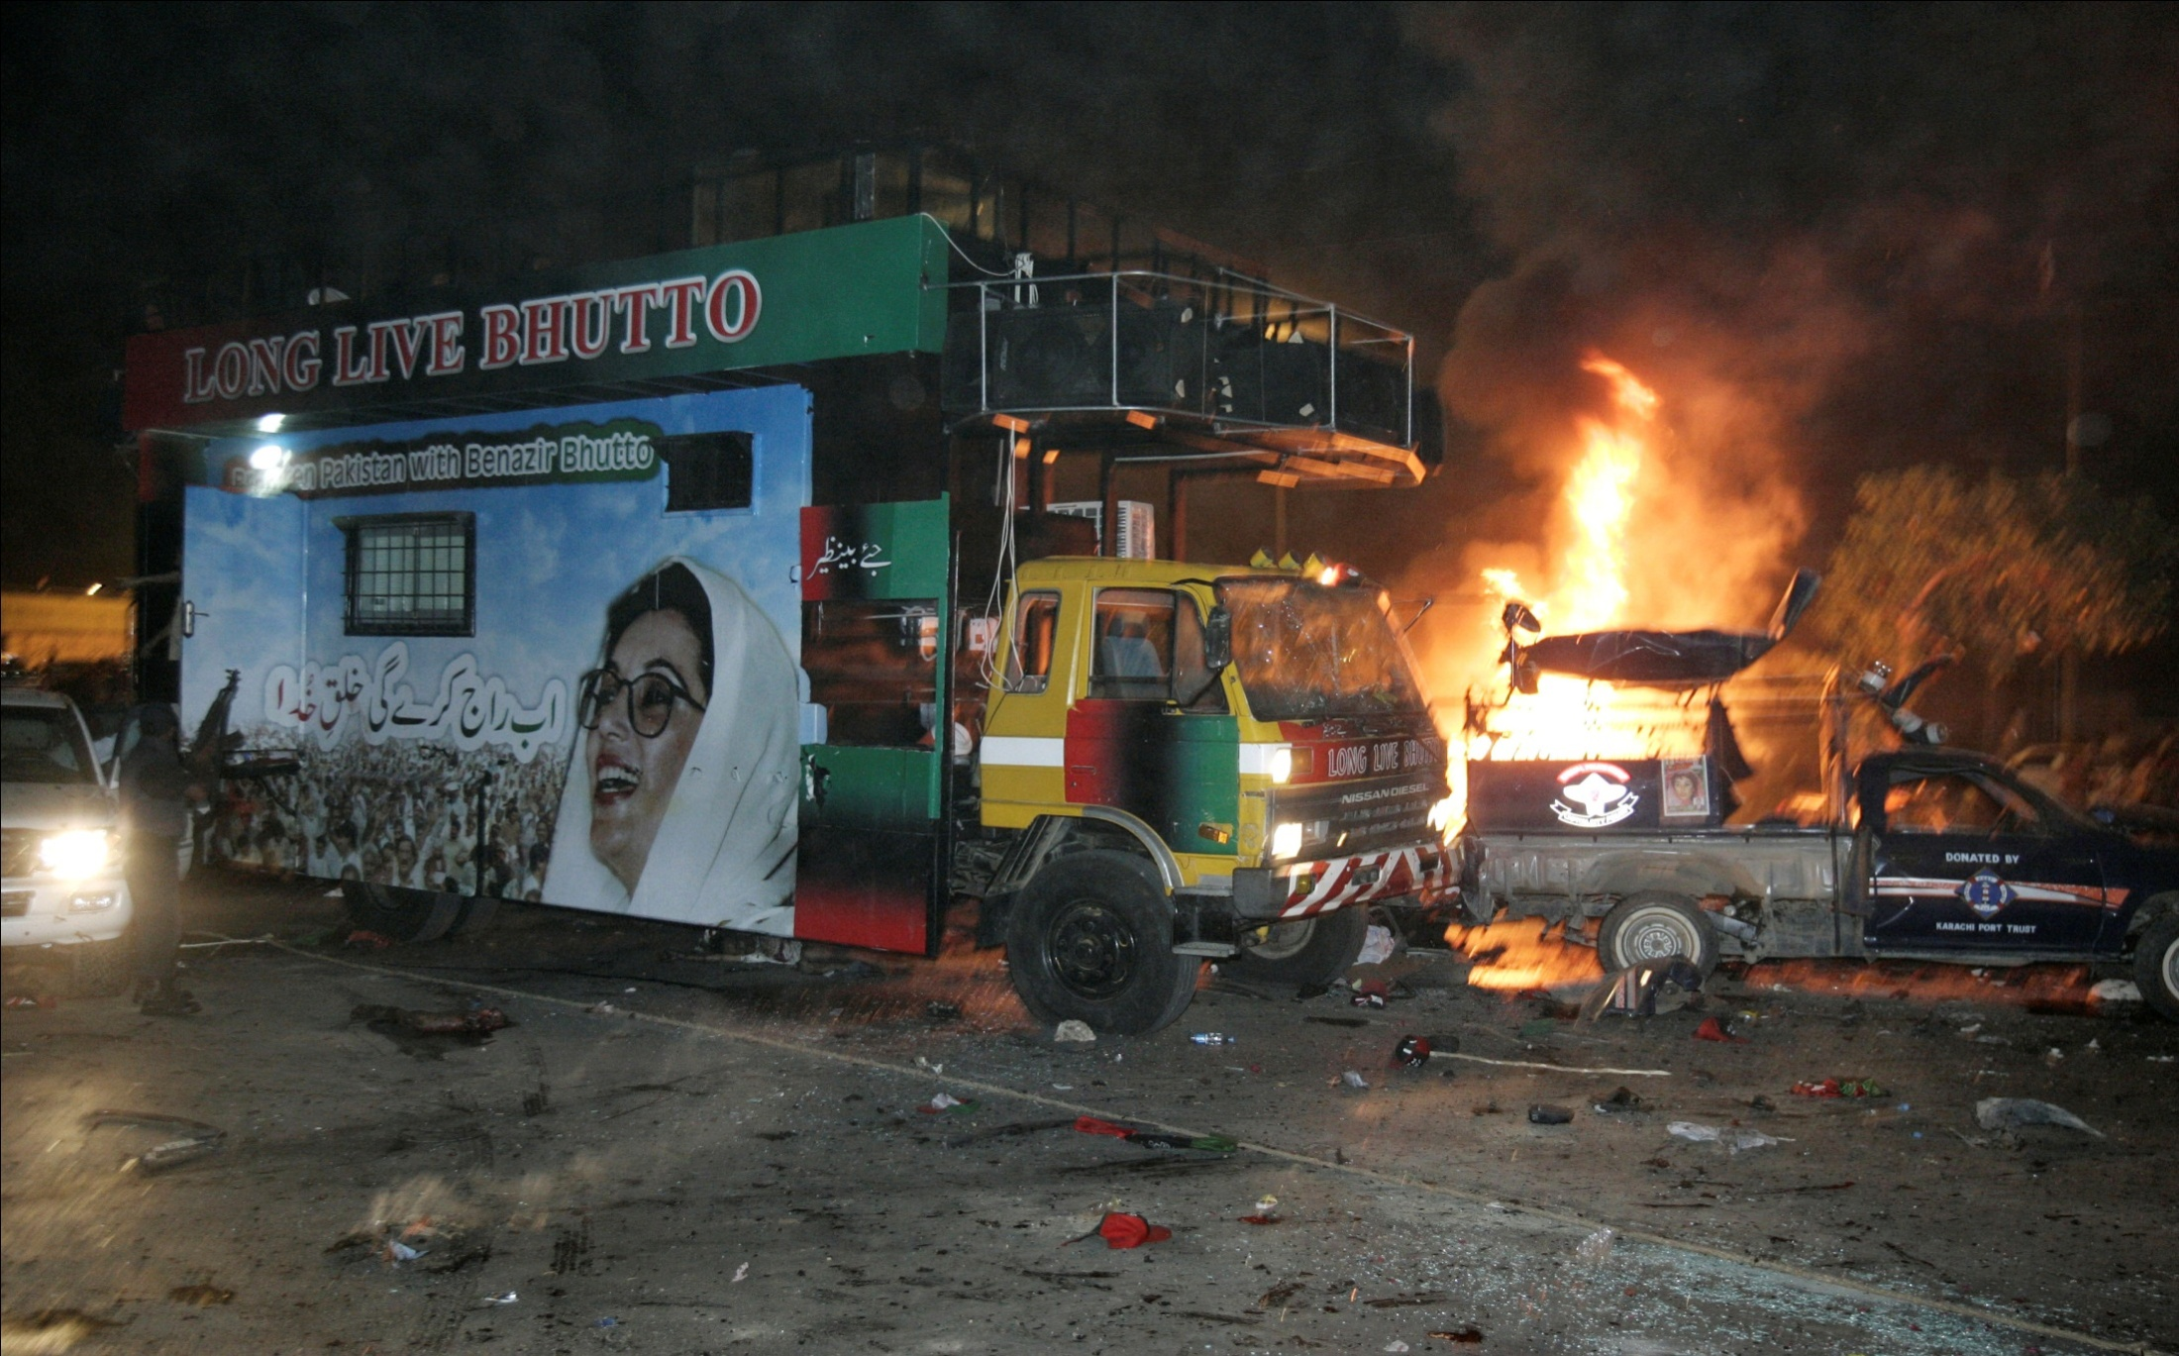
Twin Suicide Attack on SMBB Cavalcade in Karsaaz Karachi – 18th Oct. 2007
170 persons were killed and 150 injured

Slide 15
…Twin Suicide Attack on SMBB Cavalcade in Karsaaz Karachi – 18th Oct. 2007
After the twin suicide attack carried out on Mohtarma Benazir Bhutto on 18th October 2007, SIG recovered striker sleeves MUV2 (Russian made) from the crime scene.
MUV2 striker sleeves with same lot number and factory code except little variation of manufacturing year was used in 11 suicide bombings in Quetta, Peshawar, Kohat, Charsadda, Rawalpindi and D.I. Khan in the year 2007.
MUV2 was first identified by CTW in Jan 2007 in the 1st suicide attack on Marriott Islamabad.

Slide 16
Terrorist Groups Re-organize
On 14th Dec. 2007, 27 militant groups from 7 tribal agencies, 6 frontier regions and 24 districts of NWFP (now KPK) formed an umbrella organization named Tahrik-e-Talban Pakistan (TTP).
Baitullah Mehsud, r/o Makeen, South Waziristan, was chosen as Amir of TTP.
In year 2007, 20 suicide bombers out of 26 known suicide bombers were from South Waziristan.
Qari Hussain Mehsud r/o Kotkai, Teh. Sararogha, SWA operated a training center for Suicide bombers at Spinkey Raghzay, Wana, SWA.
TTP formation gave a new impetus to terrorism in FATA & rest of the country.

Slide 17
Tehrik-e-Talban Pakistan in 2007
North
Waziristan
Hafiz
Wahidullah,
Sadiqullah
Bajaur
Amir:
Maulvi Faqir
Mohammad
South Waziristan
Mehsud
Qari Hussain
Wazir
Noor Islam
Swat
Amir:
Maulvi
Fazlullah
Mohmand
Amir:
Abdul Wali
Kurram
Noor
Muhammad
Bait Ullah Mehsud
Supreme Commander
Amir
Nazim e Ala: Maulvi Faqeer Mohammad
Nazim e Ala: Maulvi Fazlullah
Spokesperson: Maulvi Umar
Orakzai
Amir:
Hakeemullah
Mehsud
Charsadda
Amir:
Shah Jehan
Tank
Asmatullah
Shaheen
Nowshera
Amir:
Maulvi Kamran
(Bannu)
Jani Khel
Qismatullah
Bakka khel
Mulla Bahadar Jan
Domail
Qari Wazir
Lakki Marwat
Inamullah,
Qari Sarfraz
Dara Adam
Khel
Amir:
Tariq Aridi
Mardan
Fazal Rehman

Slide 18
Suicide Bombing Incidents Analysis (2004 –2011) Escalation of Terrorism in 2007 is visible
Year | Sindh | Punjab | Balochistan | KPK | ICT | G.B/ AJK | Total
 |  |  |  |  |  |  | Attacks | Killed
2004 | 2 | 4 | 1 | 0 | 0 | 0 | 7 | 130
2005 | 1 | 0 | 1 | 0 | 1 | 0 | 3 | 81
2006 | 3 | 0 | 1 | 4 | 0 | 0 | 8 | 145
2007 | 1 | 11 | 2 | 27 | 3 | 0 | 44 | 614
2008 | 0 | 9 | 2 | 32 | 4 | 0 | 47 | 587
2009 | 0 | 14 | 1 | 43 | 6 | 3 | 67 | 705
2010 | 3 | 7 | 3 | 27 | 0 | 2 | 42 | 668
2011 | 2 | 2 | 4 | 25 | 1 | 0 | 34 | 452
Total | 12 | 47 | 15 | 158 | 15 | 5 | 252 | 3382
    Note: Suicide bombing incidents in FATA are not included in these figures.
Notes:
Update figures 2004 to 2011

Slide 19
PART – III
INVESTIGATION

Slide 20
… Why Was Mohtarma Benazir Bhutto Assassinated?
After the Karsaz attacks terrorists carried out few more attempts in Swabi & Peshawar but failed due to stingent security measures
Terrorists were provided an opportunity in Rawalpindi on 27th December, 2007 due to breach of security by Police.
At least one accused Husnain Gul had a personal motive as his very close friend Qari Fayaz was killed in Lal Mosque operation. (Stated in his 164 Cr P.C Statement)

Slide 21
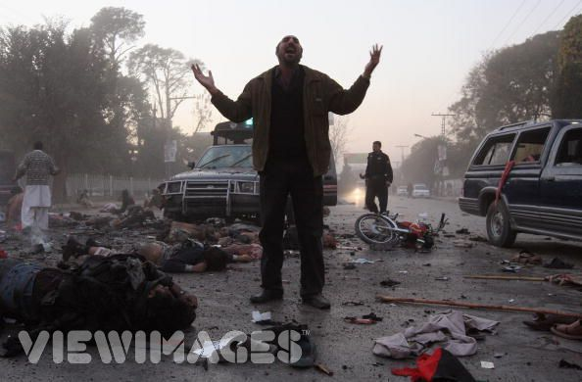
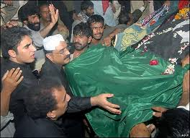
Liaqat Bagh Rawalpindi
27th Dec. 2007

Slide 22
Important Facts
Incident occurred at 1710 hrs. when Mohtarma Benazir Bhutto was leaving Liaqat Bagh venue.
An assailant fired three shots from a .30 bore pistol and then exploded himself approx. 3 meters from the vehicle.
Mohtarma was taken to Rawalpindi General Hospital 05 kms away and was provided emergency medical treatment but she succumbed to her injuries at 1815 hrs.
23 other persons were also killed and 70 injured due to the bomb blast.
Notes:
link

Slide 23
Important Facts
Crime Scene
Police deliberately washed the crime scene within 1 hour &
20 minutes of the incident resulting in destruction and disappearance of vital evidences. Hence subsequent organized crime scene forensic examination was not possible.
Post Mortem
Police failed to get conduct post mortem of Mohtarma’s
dead body, causing controversy about the cause of death.
Press Conference
Brig. (R) Cheema’s premature press conference ‘even’ before any investigation was conducted created doubts and controversy about cause of death of SMBB & Involvement of
Baitullah Mehsud.
The investigation and prosecution of this case will suffer
from these deficiencies.
Notes:
link

Slide 24
Recoveries from Crime Scene
One 30 bore Pistol along with 01 loaded magazine (03 live and 01 damaged bullet) and 01 damaged magazine. DNA found on the pistol matched with DNA of suicide bomber (Saeed @ Bilal) – Scotland Yard Report.
One 9mm Pistol with magazine and 05 bullets (carried by Toqeer Akram Kaira r/o Lala Musa Gujrat, killed in blast)
02 empties of 30 bore pistol and 02 ball bearings.
Body parts, skull bone and skin of the face of the suicide bomber. Face of suicide bomber was reconstructed
24

Slide 25
Investigation by Rawalpindi Police
On 27.12.07, after the incident, SHO/PS City, Rawalpindi, registered a criminal case FIR No. 471/07 on the basis of his own complaint and carried out initial investigation.
On 28.12.2007 Govt. of Punjab notified a JIT consisting of the following officers of Punjab Police to carry out investigation:-
  Ch. Abdul Majeed - Adl. IGP, CID. Convener
  Mr. Mushtaq Sukhera - DIG, CID Member
  Mr. Waqar Chohan - SSP, Member Regional Inv. RWP
  Mr. Tahir Ayub - SP, Inv, RWP Member
25

Slide 26
…Investigation by Rawalpindi Police
On 04-01-2008 Police procured a CD containing intercepted telephonic conversation in Pushto between one Moulvi Sahib (unknown) and Ameer Sahib (Bait Ullah Mehsud).
Urdu Transcript of Pushto CD was prepared
Rawalpindi Police arrested accused Aitezaz Shah , R/O Mansehra & Karachi and Sher Zaman Mehsud R/O DI Khan.(Arrested on 21-01-08), Hasnain Gul and Rafaqat Hussain R/O Rawalpindi. (Arrested on 07-02-08), Rasheed Ahmad @ Abdul Raheem Turabi R/O Charsadda. (Arrested on 14-02-08)
26
Notes:
Profiles of Sher Zaman and Rashid Turrabi to be prepared in hyper link

Slide 27
…Investigation by Rawalpindi Police
Confessional Statements of accused Aitezaz Shah, Rafaqat Hussain, Hasnain Gul and Rasheed Ahmad Turabi were recorded u/s 164 Cr.PC before a Magistrate on 13-02-2008 & 15-02-2008 .
Two separate charges were framed against the accused on 22.11.2008 in ATA Court Rawalpindi.
27

Slide 28
Accused Arrested
S.No | Name | Role
1 | Aitezaz Shah, R/O Mansehra & Karachi. (Arrested on 21-01-08) | Knowledge of conspiracy . Also identified the voice of Baitullah Mehsud from intercepted CD. (Statement u/s 164, CrPC recorded)
2 | Sher Zaman Mehsud R/O DI Khan. (Arrested on 21-01-08) | Knowledge of conspiracy. Also identified Abdullah @ Saddam, Qari Ismail and Nasarullah.
3 | Hasnain Gul R/O Rawalpindi. (Arrested on 07-02-08) | In contact with conspirators in Madrassah Haqqania i.e Qari Ismail, Abad-ur-Rehman and Nasarullah. Involved Rafaqat in the execution of the plan. Handler and facilitator of suicide bombers in RWP. He also conducted recce in Nov 2007. He kept suicide jackets and weapons in his residence for the suicide bombers. (Statement u/s 164, CrPC recorded)
28

Slide 29
…Accused Arrested
S. No | Name | Role
4 | Rafaqat Hussain R/O Rawalpindi. (Arrested on 07-02-08) | Handler and facilitator of S.Bs in RWP. S.Bs stayed at his residence. Operators and S.Bs used his taxi in RWP. He also conducted recce along with Nasarullah on 27-12-07. (Statement u/s 164, CrPC recorded)
5 | Rasheed Ahmad @ Abdul Rehman Turabi R/O Charsadda. (ex-student of Haqqania) (Arrested on 14-02-08) | Knowledge of conspiracy. Also identified Abdullah @ Saddam, Qari Ismail, Nasarullah and S.B Bilal. (Statement u/s 164, CrPC recorded)
29

Slide 30
Accused Absconding/Killed
S. No | Name | Role
1 | Baitullah Mehsud r/o South Waziristan Agency, (Amir of TTP) | Mastermind (Killed in a drone attack on 05-08-09)
2 | Nadir Khan @ Qari Ismail Khan, R/O Swabi. (ex-student of Haqqania) | Incharge of operation in Haqqania Madrassah. Also in contact with Nasarullah. (Killed in Mohmand Agency on 15-01-2008)
3 | Nasrullah, R/O Miranshah NWA. (ex-student of Haqqania) | Focal person of conspiracy in RWP. In contact with Moulvi Sb on 28-12-07. (Killed in Mohmand Agency on 15-01-2008)
4 | Abad ur Rehman @ Noman, R/O Malakand Agency. (ex-student of Haqqania) | Co-conspirator. Provided suicide jackets to Hasnain. (Killed in Tirah, Khyber Agency in a Drone attack on 13.05.2010, alongwith 14 other militants including foreigners)
30

Slide 31
…Accused Absconding/Killed
S. No | Name | Role
5 | Abdullah @ Saddam, S/O Ali Rehman, R/O Mohmand Agency. (ex-student of Haqqania) | Knowledge of conspiracy. Provided suicide jackets to Hasnain. Also involved in Kamra Missile Attack (17-01-08). (Killed in Mamad Gatt, Mohammand Agency in an explosion on 31-05-2008)
6 | Faiz Mohammad @ Kaskat, S/O Shah Nazar, R/O Swabi. (ex-student of Haqqania) | Provided suicide jacket to Hasnain.
7 | Saeed @ Bilal, R/O Barwand, SWA | S.B Killed
8 | Ikram Ullah R/O Barwand, SWA | Second Suicide bomber, escaped.

Slide 32
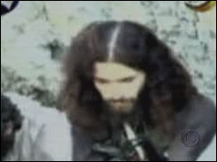
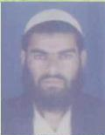
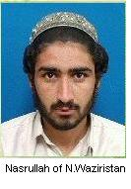
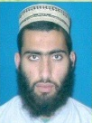


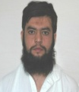
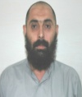

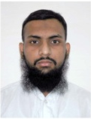

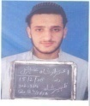
Connection between TTP/AQ and Accused of SMBB Case
0965-238387
Moulvi Sb ?
Wana/SWA
0928-230493
Ameer Sb / Baitullah Mehsud (Killed on 05.08.2008)
0963700877 – A number in contact with Nasrullah appeared in
TTP/AQ Kidnappings in Karachi. (Satish Anand-20.10.2008 & Aqeel Haji- 18.11.2008)
28-12-2007
7:51 AM
Madrassa Haqqania, Akora Khatak – Room # 96
Qari Ismail
R/o Village Khazana, Kala Bat, Tehsil & Distt. Swabi
0344-6654236
(Killed on 15-01-08)
Nasrullah
R/o Village Dirnomi Saidgai, Miranshah, North Waziristan Agency
(In Rawalpindi on 27-12-07)
0304-9684538
(Killed on 15-01-08)
Abad ur Rehman
R/o House No. 4, G/89, POF Sanjwal Cantt, Tehsil & Distt. Attock.
Permanently Bazdara Payan, PO Panai, Tehsil Bat Khela, Distt. Malakand
(In Lower Dir on 27-12-07)
(Killed on 13.05.2010)
0344-9666465, 0346-9442498
Abdullah @ Saddam
(Killed on 31.05.2008)
Faiz Muhammad @ Kaskat
Saeed @ Bilal
Suicide Bomber
Ikram Ullah
Second Suicide Bomber
Rasheed Ahmad @ Abdul Rehman Turabi R/O Charsada. Arrested on 22-01-08.
Sher Zaman Mehsud R/O DI Khan. Arrested on 22-01-08.
Hasnain Gul @ Ali Pinjabi
R/O Street 7, Jevan Colony, Dhoke Syedan, Rawalpindi
0332-5609682
051-8000236
Rafaqat Hussain
R/O House AD/90, Street 1/8, Ahmedabad, Quaid-e-Azam Colony Rawalpindi
0331-5013836
Aitzaz Shah @ Saifullah
R/o Sangal Kot, PS Batal, Tehsil & District Mansehra, Presently House No.4, Azeem Shah Building, Metrowel No.2, near Masjid Quba, Karachi
32

Slide 33
Investigation By Scotland Yard
On the request of Govt. of Pakistan, Scotland Yard team arrived on 04.01.2008 and submitted report on 01.02.2008 concluding that:
  The same attacker who fired on Mohtarma BB also carried out suicide attack.
  The death of Mohtarma BB occurred when her head struck the side of escape hatch because of the impact of the blast.

Slide 34
… Investigation By Scotland Yard
In his report Dr. Cary, a leading Forensic Pathologist of UK, concludes that:
  “the only tenable cause for the rapidly fatal head injury in this case is that it occurred as the result of impact due to the effects of the bomb-blast”
  “in my opinion Mohtarma Benazir Bhutto died as a result of a severe head injury sustained as a consequence of the bomb blast and due to head impact somewhere in the escape hatch of the vehicle.”
  “Given the severity of the injury to Ms Bhutto’s head, the prospect that she inadvertently hit her head whilst ducking down into the vehicle can be excluded as a reasonable possibility.”
34

Slide 35
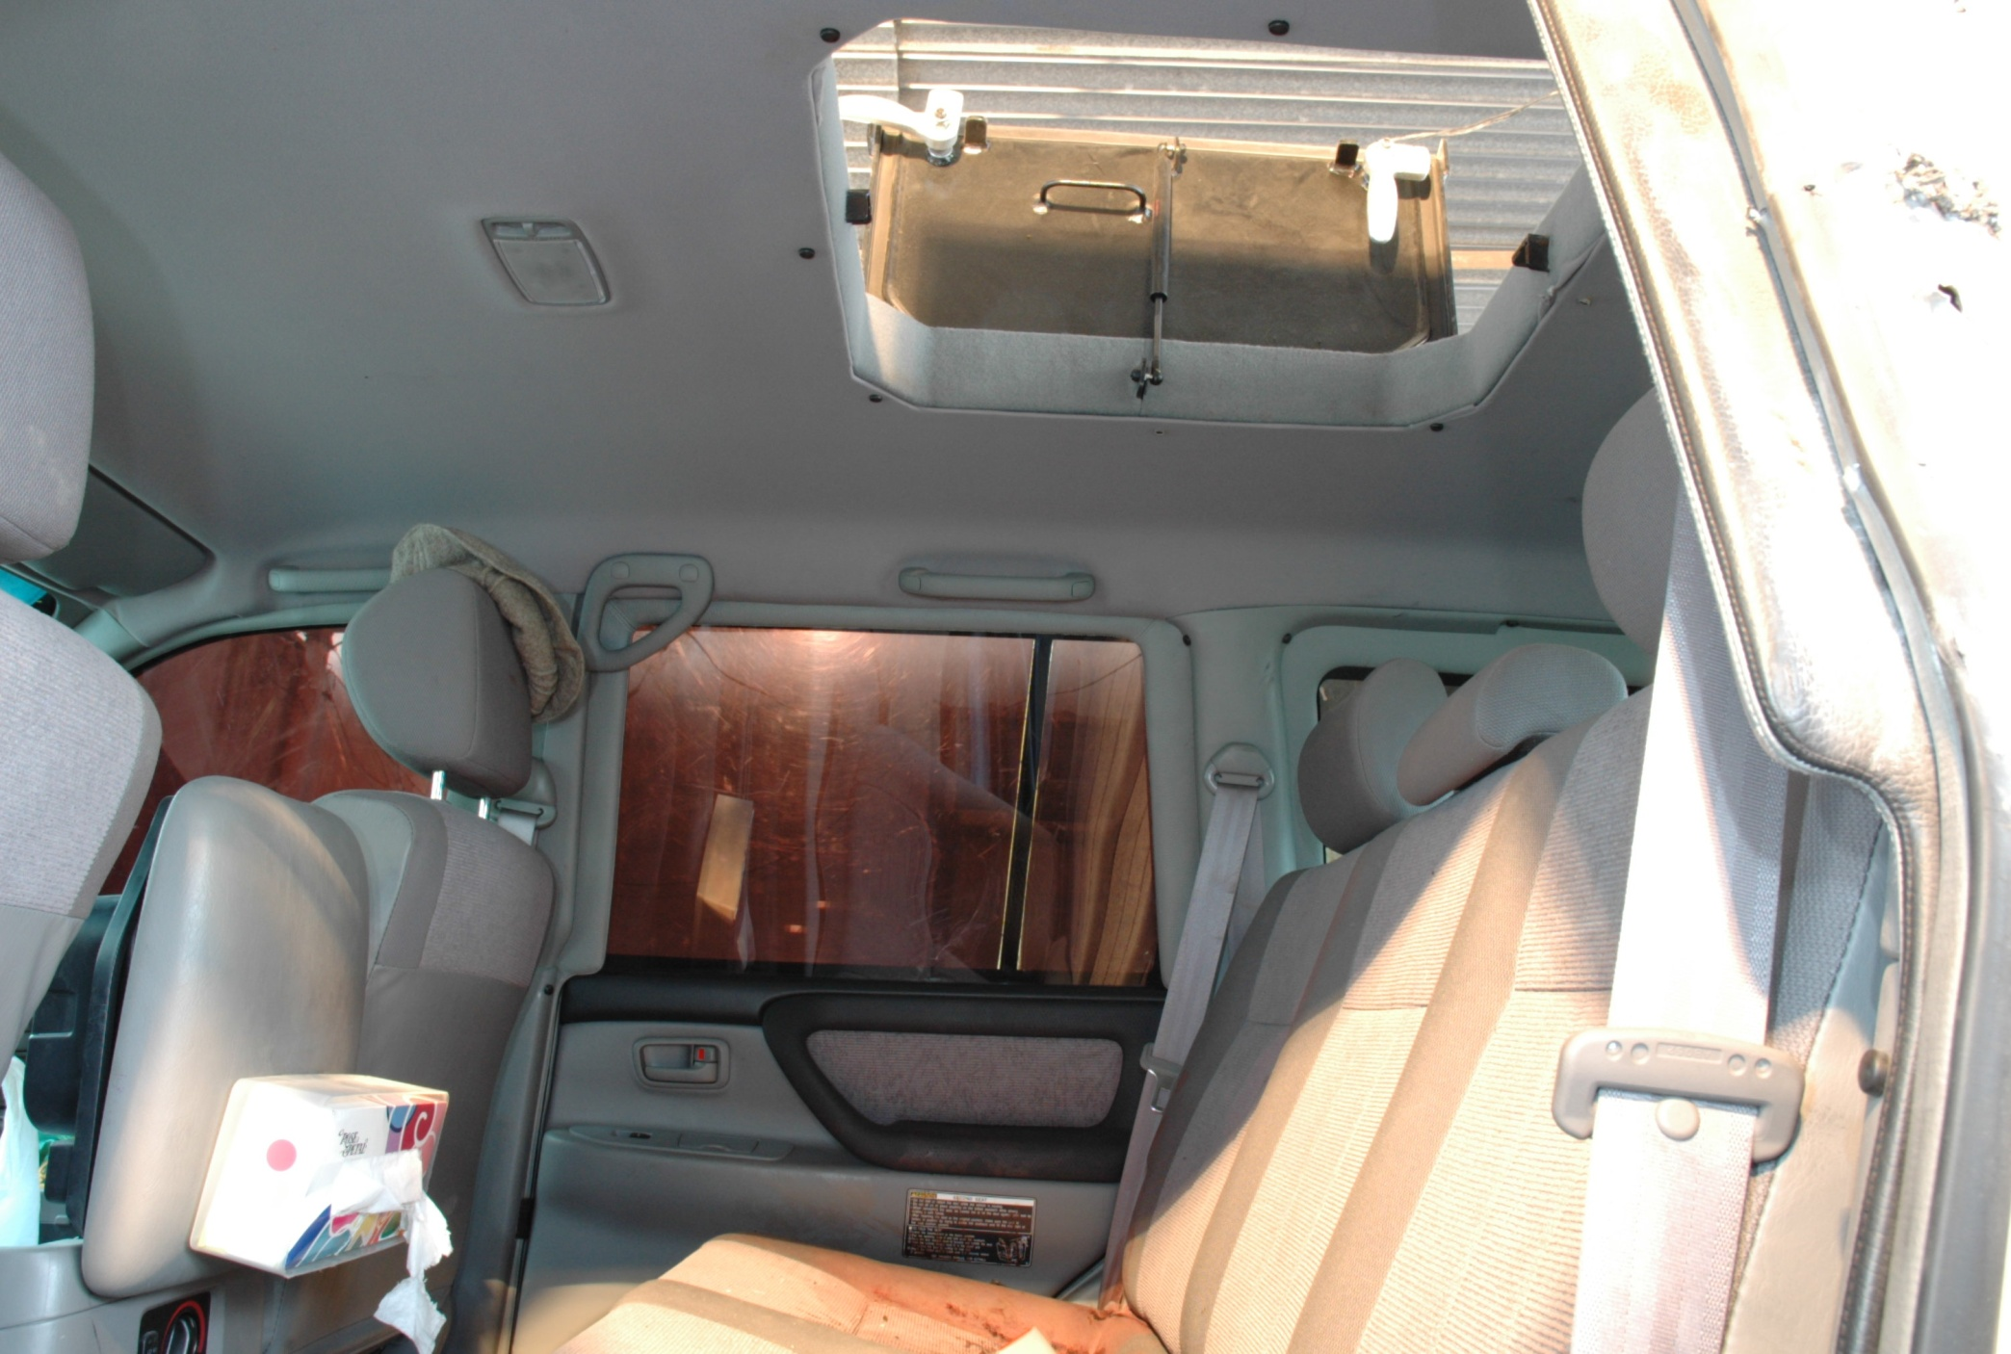
Interior of Armoured Land Cruiser of Shaheed Mohtarma Benazir Bhutto

Slide 36
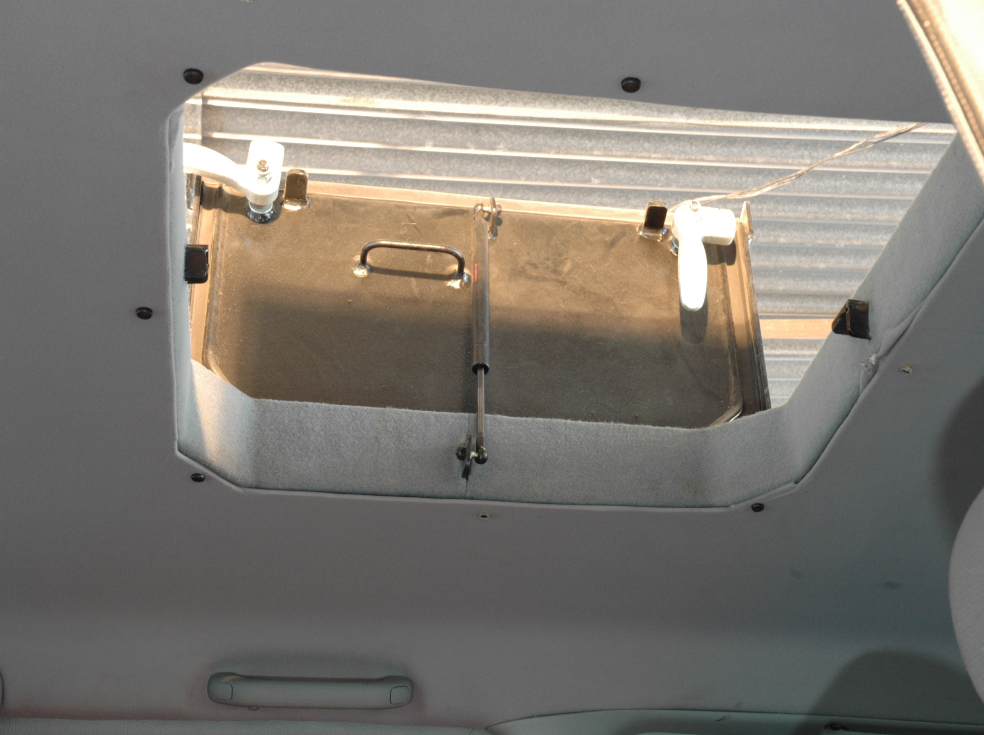
Close up of the escape hatch of Armoured Land Cruiser

Slide 37
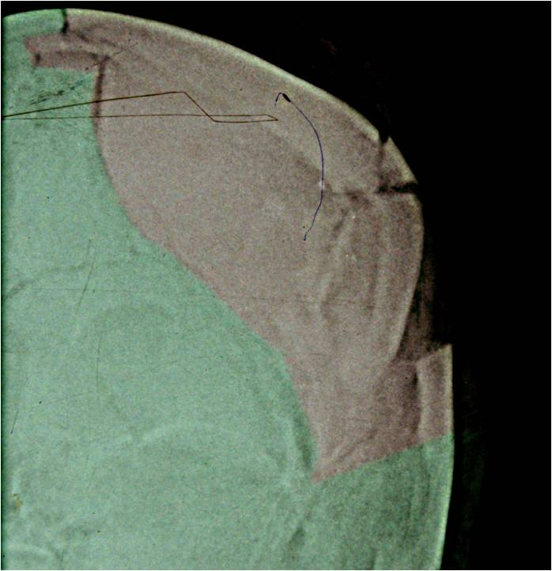
X-Ray showing right side head injury of
Shaheed Mohtarma Benazir Bhutto

Slide 38
Deficiencies in Police Investigation
Crime scene washed at 6:40 p.m (ordered by SP Khurram Shehzad with consultation of CPO Saud Aziz)-
CPO Saud Aziz failed to get conducted postmortem of Mohtarma Benazir Bhutto.
No postmortem of 19 deceased/victims carried out (05 more injured persons died later on).
No identification parade conducted of arrested accused.
No approver made from 04 confessing accused.
38

Slide 39
…Deficiencies in Police Investigation
Police investigation mainly relied on confessional statements of 04 accused, which required corroboration.
Three absconders (Abad, Saddam and Kaskat) were not even identified.
Haqqania Madrassa record of accused was not procured.
Statement of author of Intercepted CD not recorded.
Statement of BDU incharge not recorded nor cited as PW.
Statements of concerned officials of mobile phone companies u/s 161 Cr.PC not recorded.
39

Slide 40
…Deficiencies
Statement of SI Iftikhar who got conducted external post mortem of 7 dead bodies not recorded nor cited as PW.
Call record of all linked phone numbers was not obtained.
Proper analysis of suspects’ phone numbers not conducted.
Liability of Police officials regarding destruction of evidence and breach of security not determined.
Federal and Provincial Govt. officials not questioned regarding provision of appropriate security cover to late Mohtarma Benazir Bhutto.
Due to reasons unexplained no judicial inquiry was held by Punjab Govt.
40

Slide 41
CASE TRANSFERRED TO JIT CTW/FIA ON 06, AUGUST 2009 by Ministry of Interior, Govt. of Pakistan
Mr. Muhammad Khalid Qureshi, DIG/ Director CTW
Mr. Wajid Zia, DIG / Director FIA
Mr. Sohail Habib Tajik, SSP.
Mr. Azad Khan, SSP.
Mr. Sajjad Haider, Deputy Director FIA
Mr. Nauman Ashraf Bodla, Deputy Director Forensics FIA
Mr. G. A Jatoi, Assistant Director FIA
Representatives of IB, ICT Police, Sindh Police and Punjab Police
41

Slide 42
Further Investigation by FIA
Statements of officials of 05 phone companies recorded u/s 161 Cr.PC (Telenor, Zong, Ufone, PTCL, Warid)
DNA sample of suicide bomber Saeed @ Bilal matched with his joggers, shawl & cap seized from Hasnain Gul residence in Rawalpindi (FBI Report)..
Forensic analysis of call record of accused Rafaqat Hussain, Hasnain Gul, Abad ur Rehman and Nasrullah etc conducted. Accused geographical locations on cell phone data corroborated the confessional statements of Rafaqat Hussain and Hasnain Gul.
42

Slide 43
…Further Investigation by FIA
Statement u/s 161 of Muhammad Ismail, Special Operator ISI, recorded regarding intercepted CD.
66 witnesses/persons examined by FIA including politicians, party leaders, police and govt. officials etc.
Original record/evidence of 04 accused namely Qari Ismail, Kaskat, Saddam and Turrabi, who resided and held meeting in Room No.96 of Hostel has been obtained / verified from Haqqania Maddrassa, Akora Khattak.
02 Black Berry cell phones of Shaheed Mohtarma Benazir Bhutto were got forensically examined.
All major findings of UN Commission report were followed up by the JIT.
43

Slide 44
…Further Investigation by FIA
The then CPO Rawalpindi Saud Aziz and SP Khurram Shehzad held responsible for destruction of evidence, breach of security and failure to get conducted post mortem. Both were arrested & are on bail.
  Statements of Dr. Abdur Rehman, Ghulam Muhammad Naz (Rescue 1122), Prof. Dr. Mussadaq, SSP Yasin Farooq and SP Ashfaq Anwar recorded u/s 164 Cr.PC.
The JIT made extensive efforts for the arrest of absconding accused in cooperation with Frontier Corps, Frontier Constablary and KPK Police. However, the mastermind and planners of the conspiracy were killed in encounters with Security forces and drone attacks.
Gen (R)Pervaiz Musharaff was challaned in the case . He was declared proclaimed offender by ATA Court Rawalpindi and his bank accounts were seized & property attached.
44
Notes:
Scan statements of Dr. Abdul Rehman, Prof. Mussaddaq, Ghulam Muhammad Naz, SSP Yasin Farooq and SP Ashfaq Anwar and Mark Siege, and creat hyper link

Slide 45
Role of Former President Gen (R) Pervez Musharraf
Gen (R) Pervez Musharraf was challaned in the case on the following grounds:
  VVIP security was deliberately denied to SMBB while the same was provided two other ex-PMs.
  His failure to provide adequate Security, commensurate to threat to SMBB, despite repeated requests assisted terrorists to carry out successful attack.
  Furthermore he threatened her not to come before elections and her security was based on the state of their relationship.
  Ordered press conference thus prejudicing & hampering investigation of the case.
Statement of Mark Siegel u/s 161 CrPC recorded in Washington– MBB received a threatening phone call from Musharraf in his presence. He also received an email from late MBB stating that Musharraf would be responsible for any harm done to her.

Slide 46
Current Status of Case
FIA, JIT submitted 05 challans against the accused persons in the trial court, i.e. Anti Terrorism Court No. 1, Rawalpindi, on 25th May 2010, 13th Nov. 2010, 22nd Dec. 2010, 7th Feb. 2011 and 11th Jan. 2012.
On 05.11.11 the learned trial court framed denovo charge against five terrorist accused namely Mohammad Rafaqat, Hasnain Gul, Sher Zaman, Aitzaz Shah and Rasheed Ahmed @ Abdul Rahim Turabi, along with two accussed Police Officers namely ex-CPO Saud Aziz and SP Khurram Shehzad.

Slide 47
Current Status of Case
05 terrorists accused namely Muhammad Rafaqat, Hasnain Gul @ Ali, Sher Zaman, Aitazaz Shah and Rasheed Ahmed @ Abdul Rahim Turrabi are confined in Central Jail Adiala, Rawalpindi, whereas 02 accused ex-CPO Saud Aziz and SP Khurram Shahzad are on bail. Accused Gen. (R) Parvaiz Musharraf had been declared proclaimed offender by the trial court.
After framing the charge against the 07 accused persons, the trial court has recorded evidence of 17 Prosecution Witnesses up-till-now.
Next date of hearing is fixed for 05 January 2013 for recording the persecution evidence.

Slide 48
Why Trial Was Delayed ?
Transfer of Judges:
  During trial four judges were transferred and now the 5th Anti-Terrorism judge is conducting the trial of the case.
Period When No Judge was Appointed
  16-05-2009 to 10-06-2009
Delaying Tactics of the Defence Counsels:
  Due to frequent absence of defence counsels in the trial court, trial of the case could not be completed.
  A Total of 135 hearing were held whereas, 36 adjournments were sought by defence counsels during recording of prosecution evidence.
Extra Efforts:
  Two Special Public Prosecutors have been appointed in the case to get conduct the prosecution of the case in the trial court and also contest the misc. petitions in High Court and Supreme Court.

Slide 49
…Why Trial Was Delayed ?
… Extra Efforts:
  During trial an application u/s 19 (&) of Anti Terrorism Act for conducting trial of the case on day to day basis was moved in the trial court on 12.09.2011 which was dismissed by the trial court. A revision petition u/s 435, 439 Cr. P.C was filed in the Lahore High Court bench at Rawalpindi against the impugned order of the trial court.
  The revision petition was accepted by the Div Bench of Lahore High Court, Bench at Rawalpindi vide order dated 17-12-2012 while given direction to the trial court for expeditious trial of the case as per direction of learned administrative judge of Lahore High Court Lahore.

Slide 50
Thank You
50

Slide 51
UN Commission Report
(15 April 2010)
Federal & Provincial Govts. failure
“The federal Government failed in its primary responsibility to provide effective protection to Ms Bhutto on her return to Pakistan.”
“There was no overall federal security plan to safeguard Ms Bhutto.”
“A range of government officials failed profoundly in their efforts first to protect Ms Bhutto and second to investigate with vigour al those responsible for her murder, not only in the execution of the attack, but also in its conception, planning and financing.”
“The failure of provincial authorities to otherwise review effectively the gross failures of the senior Rawalpindi police official and deal with them appropriately constitutes a broader whitewash by Punjab officials.”
“The police’s security plan, as written, was flawed, containing insufficient focus on Ms Bhutto’s protection.”

Slide 52
UN Commission Report
Why was she targeted?
“Ms Bhutto’s return from exile in 2007 occurred against this backdrop. Therefore, a discussion of the threats to Ms Bhutto and of the forces that felt threatened by her potential return to power in Pakistan must include the following: Al-Qaida, Taliban and local jihadi groups and elements of the Establishment.”
“She believed that the policies she advocated- a return to civilian rule and democracy, human rights, negotiations with India, reconciliation with the non-Muslim world, and confrontation with radical Islamists- threatened the Establishment’s continued control of Pakistan.”

Slide 53
UN Commission Report
Crime Scene washing
“The decision to use a fire hose on the crime scene within one hour and forty minutes of the attack- allegedly because of civil unrest and in order to prevent rioting- is not acceptable, and effectively destroyed evidence. This destruction made it extremely difficult if not impossible to gather more DNA did irreparable damage to the crime scene.”
“The Commission is not convinced that the decision to wash the scene was made by CPO Saud Aziz alone.”
“CPO Saud Aziz again appears in a setting in which he seems to have been able to impede the effective investigation of the crime. Again, it is unlikely that a police officer of his level could make such significant and ultimately destructive decisions on his own and wield such power.”

Slide 54
…UN Commission Report
“In short, the Punjab committee constituted a whitewash of the actions of the Rawalpindi police in failing to manage the crime scene and destroy evidence. Not surprisingly, the work of the Punjab committee was counterproductive in that it further deepened the suspicion of many in Pakistan over the conduct of the police on 27 December 2007.”
“Maj Imtiaz did not provide leadership after the attack, although he was assigned to the team precisely for this reason”………”He was not able to work effectively with federal or local authorities to plan security arrangements in advance or receive adequate information from them.”

Slide 55
UN Commission Report
Absence of an autopsy
“The absence of an autopsy caused serious damage to the investigation. The lack of a clear cause of death established by an autopsy severely affected the credibility of the Government among the general public and has given rise to wide speculation as to the cause of Ms Bhutto’s death.
“The Commission is persuaded that the Rawalpindi police chief, CPO Saud Aziz, did not act independently of higher authorities, either in the decision to hose down the crime scene or to impede the post-mortem examination.”

Slide 56
UN Commission Report
Govt. Press Conference
“The Government press conference of 28 December 2007- the day after the assassination and the day that the Joint Investigation Team was formed- prejudiced the investigation and eroded public confidence. This problem is especially acute because Pakistan was led by a military government in a society in which the military has significant and broad authority. The Commission concludes that the decision for the press conference was made by General.”

Slide 57
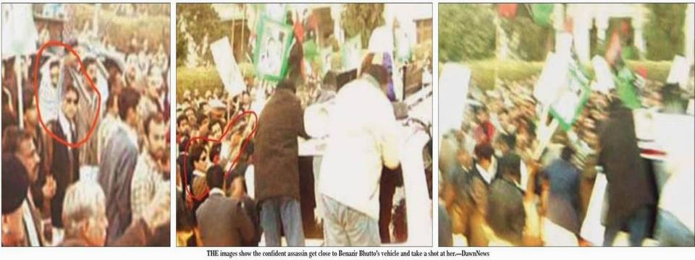
1
2
3
57

Slide 58
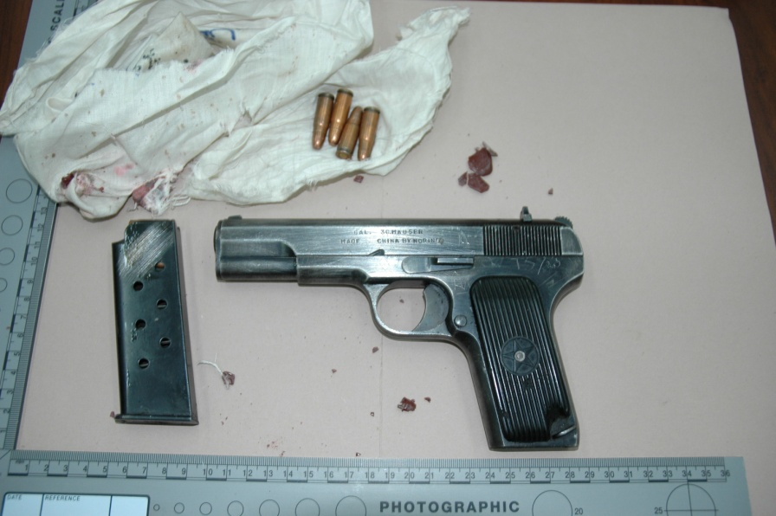
.30 Bore Pistol used by the Suicide Bomber
Matching empty was recovered on 29th Dec. from the Water Drain
58

Slide 59
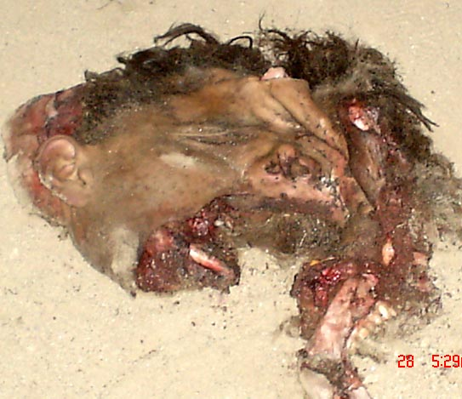
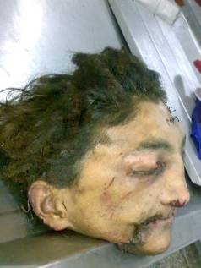
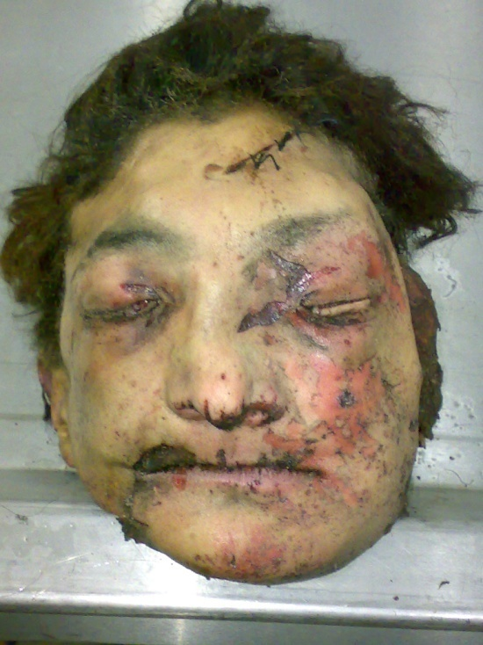
Reconstruction of Suicide Bomber’s Face
The Suicide Bomber- Saeed @ Bilal r/o Barwand, South Waziristan

Slide 60

Aitzaz Shah @ Saifullah
R/o Sangal Kot, PS Batal, Tehsil & District Mansehra, Presently House No.4, Azeem Shah Building, Metrowel No.2, near Masjid Quba, Karachi
Date of birth | 17-02-1992
Father Name | Syed Zaheer Ahmed Shah,
Caste | Syed
Education | Hifz-e-Quran from Madrassah Jamia tul Uloom Karachi.
Brief | Motivated for jehad by his cousin Hafiz Ismail His madrassah fellow Ameer Ullah sent him to Waziristan for weapons training. He went to Afghanistan for jehad and on return he was motivated by Maulana Ishaq (Imam Mashid) for suicide bombing in 2007. He was imparted suicide and car driving training in Tangai Suicide Training Camp by Roza Din r/o Ladha, SWA. Roza Din handed him over to Wali Muhammad and Sher Zaman who told him that his turn for suicide bombing has come and target will be Benazir Bhutto. He remained in Dhelay suicide camp for three months. Later on he was arrested in D.I.Khan on 17-01-2008.
60

Slide 61
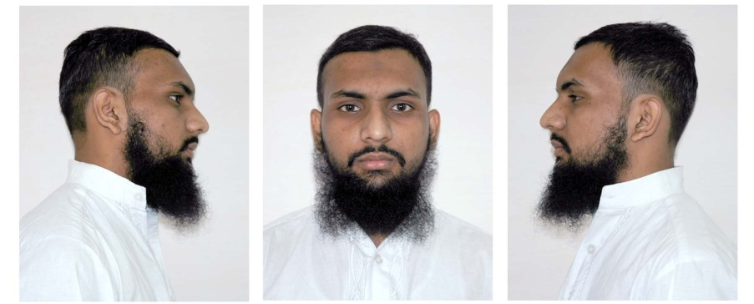
Hasnain Gul @ Ali
R/O Street 7, Jevan Colony, Dhoke Syedan, Rawalpindi
Date of birth | 18 years old
Father Name | Muhammad Riaz
Education | Middle, Madrassah Taleemul Islam Wehsia Hazro, Madrassah Muhammadia, China Chowk, Islamabad
Brief | In 2005 Qari Fayaz (friend of Hasnain – Killed in Lal Masjid) took Hasnain to Training Center of Qari Abbas in Miran Shah, NWA. There he met Qari Ismail a student of Madrassah Haqqania, Akora Khattak. Qari Ismail and Nasarullah (both killed in Mohmand Agency) were students of Madrassah Haqqania and Nasarullah was focal person on Liaqat Bagh incident. Nasarullah brought suicide bombers for Liaqat Bagh incident
61

Slide 62
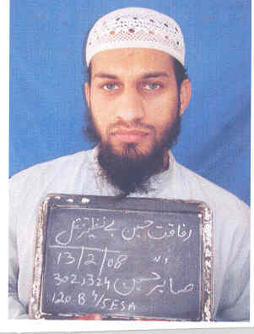
Rafaqat Hussain
R/O House AD/90, Street 1/8, Ahmedabad, Quaid-e-Azam Colony Rawalpindi
Date of birth | 24 Years
Father Name | Sabir Hussain
Education | Matric (2000)
Brief | Rafaqat is cousin of Hasnain Gul In 2007 he met with Qari Ismail student of Madrassah Haqqania, Akora Khattak along with Hasnain Gul, both motivated Rafaqat for suicide attacks. Qari Ismail and Nasarullah (both killed in Mohmand Agency) were friends and students of Madrassah Haqqania and Nasarullah was focal person on Liaqat Bagh incident. Nasarullah brought suicide bombers for Liaqat Bagh incident
62

Slide 63
Nadir Khan @ Qari Ismail
R/o Village Khazana, Kala Bat, Tehsil & Distt. Swabi
Father Name | Musafar Khan
Education | Madrassah Haqqania, Akora Khatak
Brief (Based upn interrogation of Hasnain Gul and Rafaqat) | Group leader of terrorist cell consisted of Haqania students and used to visit Mamba ul Uloom at Miranshah which is the headquarters of all militant organizations fighting from NWA. The cell members included :- Nasrullah Khan s/o Mir Alam Khan r/o Miranshah (Focal person of Liaqat bagh Incident – Killed in Mohmand Agency) Ibad ur Rahman@Noman @ Usman, r/o Malakand (Absconder) Hasnain Gul @ Ali s/o Muhammad Riaz r/o Rawalpindi (Arrested) They defected away from Haqqani Group as the latter was active only in Afghanistan and was not operating in Pakistan. This group joined Baitullah Mahsud group in 2007 after military operations in Bajaur, Mirali, etc. Ismail being the group leader, used to visit Baitullah Mahsud frequently.

Slide 64
…Nadir Khan @ Qari Ismail
R/o Village Khazana, Kala Bat, Tehsil & Distt. Swabi
Brief (Based upn interrogation of Hasnain Gul and Rafaqat) | Once Ismail informed his group members that the Ameer (Baitullah Mahsud) wants to target Benazir Bhutto as she is against Mujahideen. In November 2007, a meeting was held at room 96 situated on the 4th floor of Haqania Madrassa for suicide attack on Benazir Bhutto. Following participated in the meeting:- Nadir Khan @ Ismail Khan Ibad ur Rahman @ Noman Hasnain Gul Nasrullah Nasrullah was to bring the suicide bomber, Nadir @ Ismail to provide logistics, Hasnain Gul to provide accommodation in Rawalpindi and Ibad ur Rahman @ Noman to coordinate the attack. Nasrullah and Nadir @ Ismail were staying at room 96 of the Haqqania Madrassa while studying there Ibad ur Rahman @ Noman used to stay illegally there. Nadir Khan @ Ismail Khan and Nasrullah were killed on 15 January 2008 in an encounter with security forces at a check post in Mohmand Agency.
64

Slide 65
Nasrullah
R/o Village Dirnomi Saidgai, Miranshah, North Waziristan Agency
Date of birth | 25-27 years
Father Name | Mir Alam Khan
Caste | Wazir
Education | Madrassah Haqqania, Akora Khatak
Brief (Based upn interrogation of Hasnain Gul and Rafaqat) | Member of terrorist cell constituted by Nadir Khan @ Qari Ismail Khan The cell members included :- Nasrullah Khan s/o Mir Alam Khan r/o Miranshah (Focal person of Liaqat bagh Incident – Killed in Mohmand Agency) Ibad ur Rahman@Noman @ Usman, r/o Malakand (Absconder) Hasnain Gul @ Ali s/o Muhammad Riaz r/o Rawalpindi (Arrested) This group joined Bait Ullah Mehsud in 2007 and under the direction of Bait Ullah Mehsud executed suicide attack on Mohtarma Benazir Bhutto on 27-12-2007.
65

Slide 66
… Nasrullah
R/o Village Dirnomi Saidgai, Miranshah, North Waziristan Agency
Brief (Based upn interrogation of Hasnain Gul and Rafaqat) | Nasrullah also participated the meeting held at Room No. 96, 4th floor, Madrassah Haqqania at Miranshah when assassination plan of Ms Bhutto was discussed. Nasrullah with Nadir Khan @ Qari Ismail Khan (Group Leader) were staying at the said room while studying there. At midnight between 26 & 27 December, 2007, Rafaqat with Hasnain Gul received him in Rawalpindi along with two SBs Saeed @ Bilal and Ikram Ullah who were lodged in Rafaqat’s house in Rawalpindi. Nasrullah also took part in carrying out reconnaissance of the target place i.e Liaqat Bagh with Hasnain and Rafaqat. Nasrullah was killed on 15 January 2008 along with Nadir Khan @ Qari Ismail Khan in an encounter with security forces at a check post in Mohmand Agency.
66

Slide 67

Ibad ur Rahman @ Noman @ Usman @ Farooq
R/o House No. 4, G/89, POF Sanjwal Cantt, Tehsil & Distt. Attock.
Permanently Bazdara Payan, PO Panai, Tehsil Bat Khela, Distt. Malakand
CNIC | 37101-3961707-9
Date of birth | 15-01-1986
Father Name | Rahmat Ullah
Caste
Education | Madrassah Haqqania, Akora Khatak
Brief (Based upn interrogation of Hasnain Gul, Rafaqat and accused arrested in Case FIR 291, PS Sadiqabad, Rawalpindi) | Close associate of Bait Ullah Mehsud and Nadir Khan @ Qari Ismail. Nadir Khan constituted a terrorist cell consisted of madrassah Haqania students of Akora Khattak. The cell members included :- Nasrullah Khan s/o Mir Alam Khan r/o Miranshah (Focal person of Liaqat bagh Incident – Killed in Mohmand Agency) Ibad ur Rahman@Noman @ Usman, r/o Malakand (Absconder) Hasnain Gul @ Ali s/o Muhammad Riaz r/o Rawalpindi (Arrested) This group joined Bait Ullah Mehsud in 2007 and under the direction of Bait Ullah Mehsud executed suicide attack on Mohtrama Benazir Bhutto on 27-12-2007. He participated in the meeting held at Room No. 96, 4th floor, Madrassah Haqqania at Miranshah when assassination plan of Mohtrama Benazir Bhutto was discussed.
67

Slide 68
…Ibad ur Rahman @ Noman @ Usman @ Farooq
R/o House No. 4, G/89, POF Sanjwal Cantt, Tehsil & Distt. Attock.
Permanently Bazdara Payan, PO Panai, Tehsil Bat Khela, Distt. Malakand
Brief (Based upn interrogation of Hasnain Gul, Rafaqat and accused arrested in Case FIR 291, PS Sadiqabad, Rawalpindi) | In the meeting he was directed to co-ordinate between Nasrullah (brought suicide bomber), Nadir Khan @ Qari Ismail Khan (Group Leader who provided logistics) and Hasnain Gul (provided accommodation in Rawalpindi). His name as “Farooq” also came on record during interrogation of Intekhab Abbasi arrested in FIR NO. 291/08 , Dated 06-06-2008 U/S 120B, 7ATA, 4/5 E.A. P.S. Sadiqabad, Rawalpindi (Recovery of three suicide vehicles in Rawalpindi planned to kill Ex-President Musharraf) that Ibad ur Rahman used to operate training camp at Soor Dhand, near Bara, Khyber Agency and close associate of Bait Ullah Mehsud. He has excellence in explosives and bomb making. He provided Suicide Bombers and Explosive laden vehicles in Dhoke Kala Khan Rawalpindi Case. Abid (suicide bomber) arrested in the same case disclosed that Ibad ur Rahman once prepared one suicide vehicle and two suicide jackets for Suicide Bombers (Abid, Rajid and Baitullah) brought by Maulvi Imran to Ingar, Mohamand Agency in winter 2007/08.
68

Slide 69

Rasheed Ahmed @ Abdul Rahim Turabi s/o Qudrat Shah caste Mohmand r/o Shabqadar Sareekh Morozai, PS Batagram, Distt. Charsadda
Date of birth | 24 years
Father Name | Qudrat Shah
Education | Madrassa Haqqania, Nowshera till 2005 Madrassa Manba-ul-Uloom, Miran Shah, SWA.
Brief | On 20.12.2007, while he was in room no. 11 of the Madrassah, his class fellow from Haqqania Nadir @ Qari Ismail, Nasrullah @ Ahmed and Abdullah @ Saddam came there. They stayed there for 2 nights and went to South Waziristan to see Baitullah Mehsud. They again stayed with him when they brought suicide bomber Saeed @ Bilal. He had the knowledge of conspiracy and knew that Baitullah Mehsud had given Rs. 4 Lac to Qari Ismail for the task. He carried out rocket attack on PAF Aeronautical Complex Kamra alongwith Said Arab and others.
69
69

Slide 70
Gist of Confessional Statement u/s 164 CrPC of Aitazaz Shah
He got initial education in Madrassa Jamia ul Uloom, Metroville, Karachi. Motivated for Jehad by his Cousin Hafiz Ismail.
His Madrassa felow Ameerullah sent him to Makeen FATA for Jehadi training. also went to Afghanistan for Jehad.
Came to Ladha, SWA and joined the camp of Roza Din Mehsud, at Tangai, and got himself registered as “Fidayee”. Met Baitullah and Qari Hussain.
Roza Din handed him over to Wali Muhammad and Sher Zaman, who told him that his turn for suicide mission has come and target will be Benazir Bhutto. However, another group carried attack.
He identified the voice of Baitullah Mehsud in the CD conversation.
Arrested on 17.01.2008 in D.I.Khan, while he was on his way to Karachi for a suicide mission.

Slide 71
Gist of Confessional Statement u/s 164 CrPC of Hasnain Gul @ Ali s/o Muhammd Riaz
  He got acquainted with Nadir Khan @ Qari Ismail of Madrassa Haqqania, Akora Khattak while undergoing weapons training in Miran Shah, NWA in 2005.
  He decided to avenge death of his madrassah fellow Fayyaz Muhammad s/o Bahir, r/o Dhodial, Mansehra, during Lal Masjid Operation in July, 2007.
  He went to Akora Khattak and met Qari Ismail where a group consisting of Qari, Nasarullah, Abad, Abdullah @ Saddam was formed to target Govt. & LEAs.
  Suicide bombers and jackets were to be provided by Qari Ismail.
  He motivated his cousin Rafaqat for terrorist acts.
  Sep 04, 2007 facilitated suicide attack in R.A Bazar, Rawalpindi.
  Oct 30, 2007 facilitated in suicide attack on Golf road, Rawalpindi.
  Nov 02, 2007 Qari Ismail gave target to kill Mohtarma Benazir Bhutto.

Slide 72
….Gist of Confessional Statement u/s 164 CrPC of Hasnain Gul @ Ali s/o Muhammd Riaz
  He facilitated Nasrullah @ Ahmed and Rafaqat in carrying out reconnaissance of the place of occurrence, boarding and lodging of suicide bombers in Rawalpindi, and bringing both the suicide bombers Bilal and Ikramullah to Liaqat Bagh.
  Dec 26, 2007 received Nasarullah & 02 S.Bs from Pirwadhai Mor (Near Daewoo), Rawalpindi alongwith Rafaqat and went to Rafaqat’s home.
  He also provided 30 bore pistol with rounds to suicide bomber Bilal and one hand grenade to 2nd suicide bomber Ikramullah.
  He identified his cell No. as 0332-5609682, Rafaqat’s 0331-5013836, Nasarullah’s 0304-9684538, Abad’s 0346-9442498 & 0334-9666465 and Qari Ismail’s cell No. as 0344-6654236.
  When he was leaving towards Murree road he heard firing and blast near Liaqat Bagh chowk.
  He met Rafaqat near Novelty cinema and dispersed.

Slide 73
Gist of Confessional Statement u/s 164 CrPC of Rafaqat Husain s/o Sabir Hussain
  His maternal cousin and brother in law namely Hasnain Gul motivated him for terrorist activities.
  Sep, 2007 went to Madrassah Haqqania with Hasnain Gul.
  Facilitated suicide attacks in RA Bazar, Rawalpindi (Sep, 2007 ) & Golf Road, Rawalpindi (Oct 30, 2007).
  5/6 days before Eid ul Azha ( Nov 2007) he, Hasnain Gul & Nasarullah carried out reccee of Liaqat Bagh.
  On 26-12-07 midnight received Nasarullah and 02 S.Bs from Pirwadhai Mor (Near Daewoo), Rawalpindi along with Hasnain Gul.
  He also lodged both the suicide bombers namely Saeed @ Bilal and Ikramullah at his house in Ahmedabad, Rawalpindi brought by Nasrullah @ Ahmed.

Slide 74
….Gist of Confessional Statement u/s 164 CrPC of Rafaqat Husain s/o Sabir Hussain
  On 27-12-07 he carried out reconnaissance of the place of occurrence at Liaqat Bagh, RWP along with Nasrullah @ Ahmed.
  He dropped suicide bomber namely Saeed @ Bilal in front of the ‘exit’ gate of Liaqat Hall on 27.12.07.
  Hasnain dropped suicide bomber namely Ikramullah in front of second gate of Liaqat Bagh.
  He disclosed his cell number 0331-5013836 along with cell number 0332-5609682 used by Hansain Gul and 0304-9684538 used by Nasrullah @ Ahmed.
  After incident he reached his taxi parked near committee chowk.

Slide 75
Gist of Confessional Statement u/s 164 CrPC of Rasheed Ahmed @ Abdul Rahim Turabi s/o Qudrat Shah.
  He stated that he is by caste Mohmand and is resident of Shabqadar Sareekh Morozai, PS Batagram, Distt. Charsadda.
  He studied in Madrassa Haqqania for two years till 2005.
  In year 2005 he went to study in Madrassa Manba ul Uloom Miran Shah, and also started taking Jehadi training.
  On 20.12.2007, while he was in room no. 11 of the Madrassah, his class fellow from Haqqania Nadir @ Qari Ismail, Nasrullah @ Ahmed and Abdullah @ Saddam came there. They stayed there for 2 nights and went to South Waziristan to see Baitullah Mehsud. He dropped them at Makeen adda in madrassah vehicle.

Slide 76
….Gist of Confessional Statement u/s 164 CrPC of Rasheed Ahmed @ Abdul Rahim Turabi s/o Qudrat Shah.
  After 2 days they came back and a young boy aged about 20 years, clean shaven, fair complexion was also with them. Abdullah @ Saddam introduced him as Saeed @ Bilal. Qari Ismail told that he is taking him to get him admitted to a Madrassah. However Abdullah @ Saddam told him that they had gone to see Baitullah Mehsud in Makeen and he had handed over Saeed @ Bilal to carry out a suicide attack on Benazir Bhutto. He also told that they were also planning to attacks in Rawalpindi.
  He also informed that Baitullah Mehsud had given Rs. 4 Lac to Qari Ismail for the task.
  After 15 days He went to Madrassah Haqqania, where he met Qari Ismail, Nasrullah and Abdullah @ Saddam, but Saeed @ Bilal was not there. He asked Nasrullah about him to which he replied that he had gone to his house. However, Abdullah @ Saddam informed that Saeed @ Bilal had carried out suicide attack on Benazir Bhutto with the help of Qari Ismail, Nasrullah and Ali Punjabi.

Slide 77
….Gist of Confessional Statement u/s 164 CrPC of Rasheed Ahmed @ Abdul Rahim Turabi s/o Qudrat Shah.
  Ater some days he again went to Madrassah Haqqania and met Said Arab @ Mufti Tariq r/o Chotta Lahore Swabi and Faiz Muhammad @ Kiskat who convinced him to carry out terrorist activities in retaliation to Lal Mosque operation and operation in FATA.
  On 15.01.2008 they went to the home of Said Arab @ Mufti Tariq in Swabi, where 05 missiles sent by Commander Abdul Wali of TTP Mohmand Agency. Sadiq r/o Swabi, Usman r/o Swabi Tehseen r/o Nowshera and Abdullah @ Saddam (all students of Haqqania Madrassah) were also there. They transported the missiles with the assistance of Faiz Muhammad @ Kiskat and fired them on Pakistan Aeronautical Complex Kamra. They missed the target and the missiles landed on civilian population.

Slide 78
1st Feb. 2008
Metropolitan Police SO15 Counter Terrorism Command
New Scotland Yard Report
“The Terms of Reference to which the UK team worked were centered upon establishing the precise sequence of events from the conclusion of Ms Bhutto’s speech at the political rally in Rawalpindi on the 27th December, until the time at which she was pronounced dead at Rawalpindi General Hospital later that day.”
“The task of establishing exactly what happened was complicated by the lack of an extended and detailed search of the crime scene, the absence of an autopsy, and the absence of recognized body recovery and victim identification processes. Nevertheless, the evidence that is available is sufficient for reliable conclusions to be drawn.”
“Within the overall objective, a particular focus has been placed on establishing the actual cause of death, and whether there were one or more attackers in the immediate vicinity of Ms Bhutto.”

Slide 79
1st Feb. 2008
Metropolitan Police SO15 Counter Terrorism Command
New Scotland Yard Report
“Considerable reliance has been placed upon the X-rays taken at Rawalpindi General Hospital following Ms Bhutto’s death. Given their importance, the X-rays have been independently verified as being of Ms Bhutto by comparison with her dental X-rays. Additionally, a valuable insight was gained from the accounts given by the medical staff involved in her treatment, and from those members of Ms Bhutto’s family who washed her body before burial.”
“Ms Bhutto’s only apparent injury was a major trauma to the right side of the head. The UK experts all exclude this injury being an entry or exit wound as a result of gunshot. The only X-ray records, taken after her death, were of Ms Bhutto” head. However, the possibility of a bullet wound to her mid or lower trunk can reasonably be excluded. This is based upon the protection afforded by the armoured vehicle in which she was traveling at the time of the attack, and the accounts of her family and hospital staff who examined her.”

Slide 80
1st Feb. 2008
Metropolitan Police SO15 Counter Terrorism Command
New Scotland Yard Report
“High explosives of the type typically used in this sort of device, detonate at a velocity between 6000 and 9000 metres per second. This means that when considering the explosive quantities and distances involved, such an explosion would generate significantly more force than would be necessary to provoke the consequences as occurred in this case.”
“Ms Bhutto’s injury is entirely consistent with her head impacting upon the lip of the escape hatch. Detailed analysis of the media footage provides supporting evidence. Ms Bhutto’s head did not completely disappear from view until 0.6 seconds before the blast. She can be seen moving forward and to the right as she ducked down into the vehicle. Whilst her exact head position at the time of the detonation can never be ascertained, the overwhelming conclusion must be that she did not succeed in getting her head entirely below the lip of the escape hatch when the explosion occurred.”

Slide 81
1st Feb. 2008
Metropolitan Police SO15 Counter Terrorism Command
New Scotland Yard Report
“In essence, all the evidence indicates that one suspect has fired the shots before detonating an improvised explosive device. At the time of the attack this person was standing close to the rear of Ms Bhutto’s vehicle. The blast caused a violent collision between her head and the escape hatch area of the vehicle, causing a severe and fatal head injury.”

Slide 82
Forensic Analysis of Call Record
Forensic analysis of available call record of accused Rafaqat Hussain, Hasnain Gul, Abad ur Rehman and Nasrullah was conducted.
Link charts of accused on the basis of available call record were prepared using i-2 analyst/ investigative software.
Location analysis of the arrested accused was carried out that corroborated their confessional statements u/s 164 CrPC.
82

Slide 83
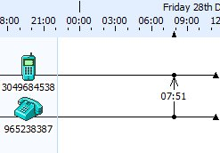
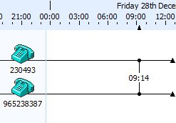
Nasrullah Received Call from “Moulvi Sahib”
&
Moulvi Sahib Received Call from Ameer Sahib
Nasarullah
(Killed in Mohmand Agency on 15-01-08)
0
Moulvi Sb
Unknown
0
SWA
Ameer Sb
Makeen, South Waziristan
0928
Intercepted Call (CD)
Moulvi Sb
Wana , South Waziristan
0
Call Record Analysis
83

Slide 84
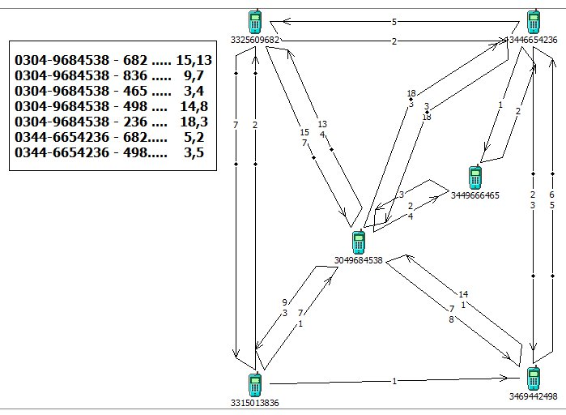
Hasnain Gul
r/o Rawalpindi
Arrested
Call Record Analysis of 05 Suspects’
(Dec 2007 – Jan 2008)
Qari Ismail
r/o Kala Bat Swabi
Killed
0
0
0
Abad ur Rehman, R/O Malakand
Killed in Khyber Agency
0
Nasrullah Wazir
r/o Miranshah, NWA
Focal Person - RWP
Killed in Mohmand Agency
Rafaqat Hussain
r/o Rawalpindi
Arrested
0
0
Abad ur Rehman
84

Slide 85






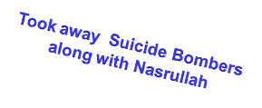
Movements of Nasarullah, Rafaqat, Hasnain, Bilal (SB) & Ikramullah (SB)
(As per Confessional Statements of Rafaqat & Hasnain)
Committee
Chowk
15:08
15:10
Daewoo
Terminal
STAGE 1
17:10
12:45
00:44
00:54
Liaqat
Bagh
STAGE 4
10:19
Tipu Road
Took away Suicide Bombers
along with Nasrullah
Misrial Road
14:02
STAGE 2
14:27
14:16
For Night Stay
STAGE 3
Residence of Rafaqat Hussain
Ahmadabad Quaid-e-Azam Colony
Notes:
85

Slide 86
Statements Recorded/Examined
Politicians
  Makhdoom Amin Faheem.
  Mr. Farhatullah Babar.
  Senator Dr. Safdar Abbasi.
  Ms. Naheed Khan.
  Mr. Zamurud Khan, President PPP Rawalpindi.
  Mr. Ayaz Khan @ Papu, President PSF Rawalpindi.
  Mr. Sagheer Shah, Dy. Gen. Sec. PSF Punjab.
86

Slide 87
….Statements Recorded/Examined
Police Officers
  Mr. Yasin Farooq, Ex-SSP Rawalpindi.
  Mr. Ashfaq Anwar, Ex-SP HQ, Rwp.
  Mr. Ishtiaq Hussain Shah, Ex-DSP City Rwp.
  Mr. Rana Shahid, Ex-DSP Rwp.
  Mr. Sultan Mahmood Chandhar, Ex-DSP Rwp.
  Mr. Kashif Riaz, Ex-SHO City Rwp.
  SI Nazar Hussain, City PS, Rwp.
  SI Zamir Ahmad, City PS Rwp.
87

Slide 88
….Statements Recorded/Examined
c. Doctors
  Dr Aurangzeb RGH, Rwp.
  Dr. Habib Ahmad Khan, Ex-Med Supt RGH, Rwp
  Dr. Nasir Khan, Asst Prof RGH, Rwp
  Dr. Qudsiya Anjum Qureshi, Ex-DD RGH, Rwp
  Dr Saeeda Yasmin, Ex-post grad trainee RGH, Rwp
  Dr. Samra Ayub, Ex-casualty med officer RGH, Rwp
88

Slide 89
….Statements Recorded/Examined
Others / Govt. Officials
  Gen (r) Hameed Gul
  Syed kamal Shah, Ex-Secretary Interior
  Brig. (r) Syed Ejaz Shah, Ex-DG, IB
  Brig. (r) Javed Iqbal Cheema, Ex-DG NCMC
  Syed Asghar Raza Gardezi, Ex-DG IB
  Mr. Khusro Pervaiz Khan, Ex-Secretary Home, Punjab
  Lt. Gen ® Tauqeer Zia.
  Col. (r) Muhammad Mohsin Mahmood, Ex-Dir. Technical, IB
  Dr. Abdur Rehman, Ex-Emergency Officer, Rescue-1122
  Mr. Ghulam Muhammad Naz, Asstt. Fire Officer, Rwp.
  Raja Walayat Khan Satti, Civil Defence, Rwp.
  Abdul Razzak Mirani, Personal Attendant to Mohtarma BB.
  Khizar Khan, Driver Zardari House.
  Mark Alan Siegel, Lobbyist and Personal friend of Mohtarma BB.
89

Slide 90
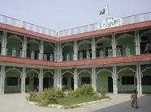
Accused’s connection with Haqqania Madrassah, Akora Khattak, Nowshera
90

Slide 91
Madrassah Haqqania, Akora Khattak,
Nowshera, KPK
A major Deoband School in Pakistan.
Provides religious education to approx 4000 students.
Most of Taliban leadership in Pak & Afghanistan including Mullah Umar & Jalaluddin Haqqani are students of this Madrassah.
Militants of banned organizations have used this madrassah & other such schools as hideouts, with or without knowledge of the management.
Six accused namely Qari Ismail, Nasrullah, Abad-ur-Rehman, Abdullah @ Saddam, Faiz @ Kiskit, Abdur Rashid Turabi were students of Madrassah Haqqania at various periods.

Slide 92
Accused’s connection with Haqqania Madrassah, Akora Khattak, Nowshera
The FIA investigations revealed that the conspiracy was hatched in Room No. 96 of Madrassa Haqqania, Akora Khattak by the former students of the Madrassah. The meeting and operation point remained Room No. 96 in Haqqania Madrassa hostel.
FIA collected original admission record (with photographs, addresses & parentage) from Haqqania Maddrassah, Akora Khattak regarding accused Nadir @ Ismail, Faiz Muhammad @ Kaskat, Abdullah @ Saddam, Rasheed Turrabi. They remained students of Madrassah Haqqania.
92

Slide 93
… Accused’s connection with Haqqania Madrassah, Akora Khattak, Nowshera
Nasrullah who had brought suicide bombers to Rawalpindi on 26 December 2007 and Abad ur Rehman, the planner, were also ex- students of Madrassa Haqqania.
Azizullah (Maulvi Sahib) to whom Baitullah Mehsud called (intercepted call) was also the student of this Madrassa who was in the room of one Anwar Shah and Ameer Sahib (Baitullah Mehsud) called Maulvi sahib from the residence of Anwar Shah.
93

Slide 94
… Accused’s connection with Haqqania Madrassah, Akora Khattak, Nowshera
94
Anwar Shah was also the student of Madrassa Haqqania.
Few other terrorists namely Said Arab, Noorul Wahab, Gul Roz involved in Kamra Rocket attack (co-partners of Rashid Turabi and currently in Attock jail) were also residing in Madrassa Haqqania with 04 accused of the case.
Maulana Sami-ul-Haq was examined who denied having any knowledge of the conspiracy by Madrassa administration. He claimed that former students still visit and stay in the hostels of the Madrassah. Management is trying to improve the identification of ex-students residing in the hostel.

Slide 95
Death of Qari Ismail & Nasarullah
Khapakh Check Post, Mohmand Agency
15 Jan 2008, Nadir @ Qari Ismail r/o Swabi (the incharge of the BB’s cell), Nasrullah r/o NWA (Focal person) and a suicide bomber were intercepted at FC check post.
Nadir killed on spot, suicide bomber exploded himself and Nasarullah died in CMH Peshawar.

Slide 96
Death of Baitullah Mehsud & Ibad ur Rehman
The mastermind of suicide attack on SMBB Baitullah Mehsud was killed in a drone attack on 05-08-2009.
FIA had obtained functional cell number of accused Ibad ur Rehman. His position was located in Khyber Agency. During tracking on 02 occasions his wrong location was conveyed by the cell phone company.
Ibad ur Rehman was killed in a drone attack in Tirah, Khyber Agency on 13-05-2010, along with 14 other militants including foreigners. This was the first drone attack in Khyber Agency.

Slide 97
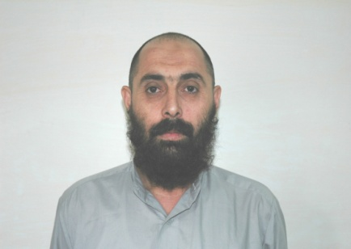
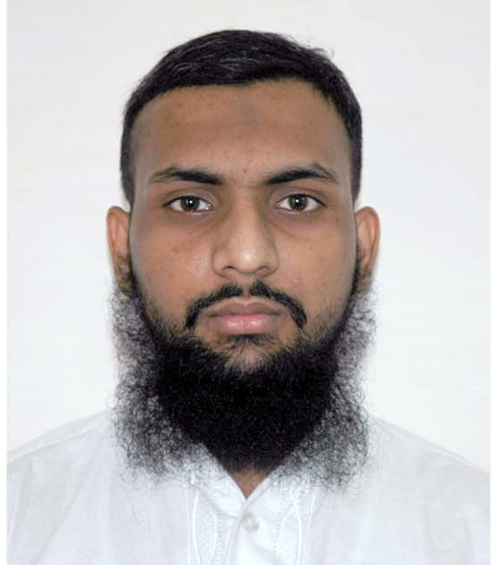
Arrested Accused and their role
1. | Aitzaz Shah @ Saifullah S/o Zaheer Shah Caste Syed R/o Sangal Kot, Mansehra, presently residing in Karachi. (Knowledge of conspiracy . Also identified the voice of Baitullah Mehsud from intercepted CD)
2. | Sher Zaman s/o Akbar Jan caste Mehsud r/o Ladha South Waziristan Agency, presently Tariqabad, D.I.Khan (Knowledge of conspiracy.)
3. | Hasnain Gul alias Ali S/o Muhammad Riaz R/o House situated in Street No. 07, Shah Jewan Colony, Dhoke Sayyadan, Rawalpindi. (In contact with conspirators in Madrassah Haqqania i.e Qari Ismail, Ibad-ur-Rehman and Nasarullah. Involved Rafaqat in the execution of the plan. Handler and facilitator of suicide bombers in RWP. He also conducted recce in Nov 2007. He kept suicide jackets)
97

Slide 98
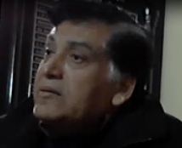
…Arrested Accused
4. | Muhammad Rafaqat s/o Sabir Hussain R/o H# AD-90, St # 8/1, Ahmedabad Quaid-e-Azam Colony, (Handler and facilitator of S.Bs in RWP. S.Bs stayed at his residence. Operators and S.Bs used his taxi in RWP. He also conducted recce along with Nasarullah on )
5. | Rasheed Ahmed @ Abdul Rahim Turabi s/o Qudrat Shah caste Mohmand r/o Shabqadar Sareekh Morozai, PS Batagram, Distt. Charsadda (Knowledge of conspiracy. Also identified Abdullah @ Saddam, Qari Ismail, Nasarullah and S.B Bilal)
6. | Syed Saud Aziz s/o Syed Aziz Ahmed, former City Police Officer, Rawalpindi. R/o 116-C, Model Town, Lahore. (Arrested on 22.12.2010) (Security Breach, Failure to conduct post mortem, Washing of crime scene)
98

Slide 99
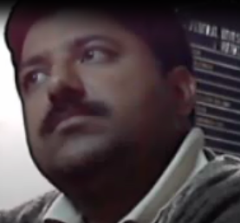
…Arrested Accused
7. | Khurram Shehzad Haider s/o Muhammad Iqbal Warriach, former SP, Rawal Town, Rawalpindi. R/o Rana Ashraf Colony, City Block, Bhalwal, District Sargodha. (Arrested on 22.12.2010) (Washing of Crime Scene)
99

Slide 100

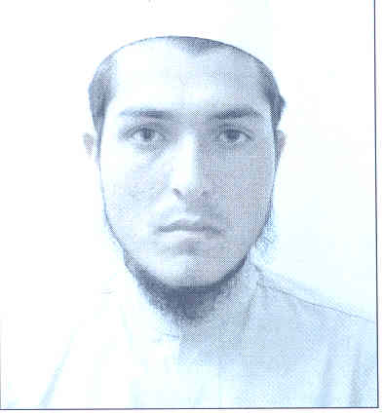
Absconders and killed P.Os.
1. | Baitullah Mehsud r/o South Waziristan Agency. (Killed in a drone attack on 05-08-09) (Chief Commander of Tahrik-e-Taliban who provided suicide bombers Saeed @ Bilal and Ikramullah)
2. | Ibad ur Rahman @ Noman @ Usman s/o Rehmatullah r/o Bazdara Payan PO ex-student of Madrassa Haqqania Palai, Tehsil Batkhela Malakand Agency, Nowshehra. (Reportedly killed in Tirah, Khyber Agency in a Drone attack on 13.05.2010, including 14 other militants including foreigners) (Provided suicide bombers and suicide vests to Rafaqat and Hasnain)
3. | Abdullah @ Saddam s/o Ali Rehman r/o Garbuz, PO Lakre, Lakre, Aden Khel, Upper Mohmond, Mohmand Agency, ex-student of Madrassa Haqqania. Akora Khattak. (Killed in Mamad Gatt, Mohammand Agency in an explosion on 31-05-2008) (Involved in planning of the incident, taking suicide bombers from Baitullah Mehsud and transportation of suicide vests in before 27-12-2007)
100

Slide 101
…Absconders and killed P.Os.
4. | Faiz Muhammad @ Kiskat s/o Shah Nazar r/o Swabi, ex- student Madrassa Haqqania, Akora Khattak (Involved in conspiracy and provision of suicide vests to Rafaqat and Hasnain in )
5. | Ikramullha r/o South Waziristan Agency (2nd suicide bomber deployed at the other gate of Liaqat Bagh Rawalpindi)
6. | Nasrullah @ Ahmed r/o Madrassa Haqqania, Akora Khattak (Killed in Mohmand Agency on 15-01-2008) (Focal person in . He took two suicide bombers Saeed @ Bilal and Ikramullah from Baitullah Mehsud, carried out reconnaissance of the place of occurrence)
101
Notes:
101

Slide 102

…Absconders and killed P.Os.
7. | Nadir @ Qari Ismail r/o Madrassa Haqqania, Akora Khattak (Killed in Mohmand Agency on 15-01-2008) (Main character of the conspiracy who took two suicide bombers from Bailtullah Mehsud)
8. | Pervez Musharraf S/o Syed Musharraf Uddin, Ex-Chief Executive & President of Pakistan. R/o Agro Farm No. 1, Chak Shahzad, Park Road, Islamabad, (Failure to provide security to SMBB. Nominated by SMBB in case any harm is done to her.) Presently in London, UK. (Absconder)
102

Slide 103
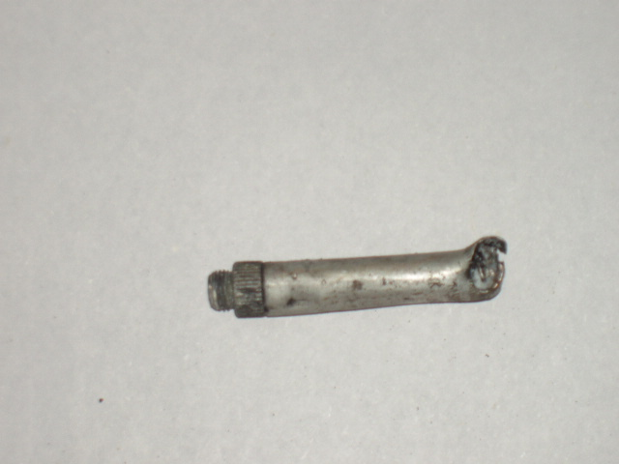
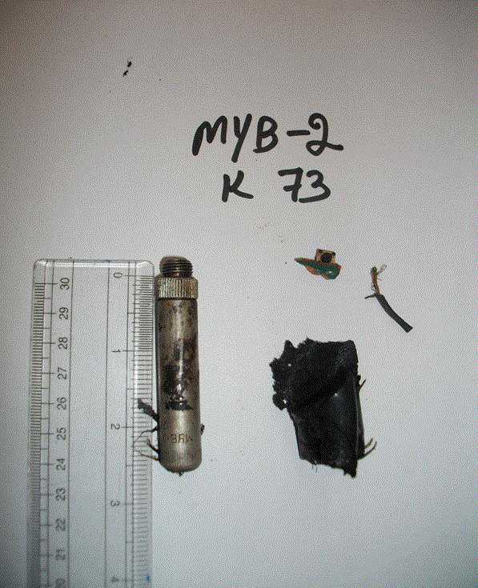
Mechanical Triggering Mechanism For Suicide Bombing
Terrorists have used striker sleeves for detonation in number of suicide bombing incidents.
Striker sleeves used in a Suicide Attack in Peshawar - 2007
Striker sleeve used in a suicide attack in Karachi in 2010
103

